Slide 1
Keyword Query Interface for RDBMS
CS 540
Shajith Ravi
Varun Rajgopal
Lakshman Kollipara
Prathamesh Patkar

Slide 2
Overview
Keyword Query Interface
Related Work
Scope
Tool Used
Results
Future Work
References

Slide 3
Why Keyword Query Interface??
Normal users - do not know SQL
Need an easier Query Interface to explore their relational databases.
Keyword Query Interface - users can submit their queries in form of keywords.
Eg: Google Keyword Query Interface
Ranked list of results that may contain the desired results
Notes:
How to deal with keyword phrases which are expressed in
the user's own words which do not appear in the RDF data?
– How to find the relevant query when keywords are ambiguous (ranking)?
– How to return the relevant queries as quickly as possible (scalability)?

Slide 4
Related work
DBXplorer:
Undirected schema graph
Node is a relation and each edge is a foreign-key relationship
BANKS:
Data graph - tuple is a node
Relationship - bidirectional edge.
DISCOVER:
Schema graph
Sequences of tuples joined into single tuple - Keywords
Notes:
DBXplorer, a system that enables keyword- based search in relational databases.
first finds the set of tables that contain at least one of the keywords.
a SQL statement is executed to join the specified relations and select rows that do contain all of the keywords
DBXplorer has been implemented using a commercial relational database and web server and allows users to interact via a browser front-end.
BANKS models tuples as nodes in a graph,
connected by links induced by foreign key and other relationships.
Answers to a query are modeled as rooted trees connecting tuples that match individual keywords in the query.
Answers are ranked using a notion of proximity coupled with a notion of prestige of nodes based on inlinks, similar to techniques developed for Web search.
We present an efficient heuristic algorithm for finding and ranking query results.
DISCOVER returns qualified joining networks of tuples, that is, sets of tuples that are associated be- cause they join on their primary and foreign keys and collectively contain all the keywords of the query. DISCOVER proceeds in two steps. First the Candidate Network Generator generates all candidate networks of relations, that is, join expressions that generate the joining networks of tuples. Then the Plan Generator builds plans for the efficient evaluation of the set of candidate net- works, exploiting the opportunities to reuse common sub-expressions of the candidate network
DataSpot
EasyAsk
NUITS : A novel user interface for efficient keyword search over databases
Easy Ask:
asyAsk e-commerce site search lets the customer tell you exactly what they want in their own words. The unique natural language technology allows your customers to express what they want – women’s medium red rain jackets under $75 – and receive the exact matching products.
Natural language also does so much more for your site (term stemming, attribute awareness, automatic spell correction, relaxation and more) that will virtually eliminate the “no results page” and deliver the best customer experience in the industry.
To deliver those objectives, a lot has to happen behind the scenes. And that’s what puts EasyAsk natural language in a class by itself with all the key features:
Deep semantic processing that relates various word forms to their core concepts, bridging the gap between text and meaning and enabling a faster, consistent shopping experience.
Automatic term stemming and spell-correction that makes the search box more tolerant of the shopper’s input and virtually eliminates the dreaded “no results” page.
Attribute awareness allows EasyAsk to immediately associate attributes such as color, size or price with products and allow searches to be highly descriptive.
Relaxation allows your site to ignore words in a search that are unknown or irrelevant to find a best possible match of products and further eliminate the dreaded “No Results” page.
Watch our videos on “Using Natural Language Product Concepts to Deliver Better Search” and “E-Commerce Money Saver: Automatic Spell Correction”:
- See more at: http://easyask.com/products/natural-language-search/#sthash.IzbERp8M.dpuf

Slide 5
Efficient IR-Style Keyword Search over Relational Databases
Complaints^{Q} = [(c3,comments,1.33), (c1,comments,0.33), (c2,comments,0.33)]
Products^{Q} = [(p1,manufacturer,1), (p2,model,1)]
[Maxtor Netvista]
Complaints^{Q}
Products^{Q}
Complaints^{Q} ← Products^{Q}
Complaints^{Q} ← Customer{} →Complaints^{Q}
Complaints^{Q} ← Product{} → Complaints^{Q}
...
SELECT * FROM Complaints^{Q} c, Products^{Q} p
WHERE c.prodId = p.prodId AND c.prodId=? AND c.custId = ?;
...
c3
p2 → c3
p1 → c2

Slide 6
Scope
Implement a keyword query interface on RDBMS.
Create indexes and run keyword search on different database schemas.
Study how changes in database design schema effect the ranking quality of the results.
Tools Considered-
Querious, SQLYog — GUI keyword Query interfaces.
Elastic Search, Solr– built on lucene from Apache,
Sphinx- simple full text search setup, can create real time indexes.
Offers excellent support on MySQL database.
Used by Craigslist.

Slide 7
Sphinx
Replaces FullText search in MySQL
Indexer
Searchd
Creates indexes on all different schemas mentioned in configuration file.
Requires unique integer value as one of the columns. Ex- id.
Use MATCH keyword and Boolean expressions.
Lists the id of rows which have matched keywords.
Works only on columns with text data type.

Slide 8
Schema Decomposition: Vertical
Schema-1(Normalized, JOIN all tables)
tbl_film (id, wikiid, guid, fbid, name, description, initial_release_date, type)
tbl_film_film_genre (id, film, genre)
tbl_film_genre(id, wikiid, guid, fbid, name, description)
Schema-2 (De_Normalized)
tbl_lak2 (id, film_id, film_wikiid, film_guid, film_fbid, film_name, film_description, initial_release_date, type, genre_id, genre_wikiid, genre_guid, genre_fbid, genre_name, genre_description)
Schema-3 (De normalized 2 tables into 1 and join on other table)
tbl_film_film_film_genre (film_id, film_wikiid, film_guid, film_fbid, film_name, film_description, initial_release_date, type, genre)
tbl_film_genre(genre_id, genre_wikiid, genre_guid, genre_fbid, genre_name, genre_description)

Slide 9
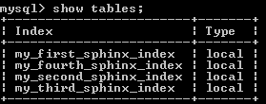
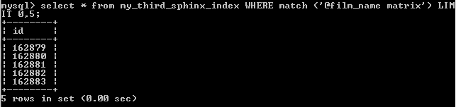
Sphinx (contd..)
Sphinx.conf
Running sphinx Indexer and Searchd
Lets check in table. tbl_lak2

Slide 10
Analysis on using sphinx as interface
Sphinx has many in-built ranking options, configurations, and index types.
Prefix @column_name to search only that particular column.
Index creation time is low
Index memory size is too high. Around 250MB
Need to create all tables with id columns, difficult when joining tables.
Less Query time compared to MATCH, AGAINST in MYSQL.
Update Indexes using updateAttribute()

Slide 11
Results
Index creation time, Index size
Searched for Movie name containing “Man” and genre name containing “Thriller”
The results were same for all schemas.
But Ordering of results are different between different schemas.
Fully De-normalized Schema Vs Normalized schema.
Normalized Schema Vs De-normalized 2 Join on another table
No Horizontal Decomposition
Results

Slide 12
Kendall Tau
Different schemas give different ranking order of results.
How to identify similarity of the orderings of data?
Kendall tau: measure of rank correlation
gives the similarity of the orderings of the data when ranked.
Kendall tau = 0.962(De-Normalized, Normalized)
Kendall tau = 0.964(De-Normalized, De Normalized2)
Kendall tau = 0.970(Normalized, De-Normalized2)
Which Schemas give more similar rank orders?

Slide 13
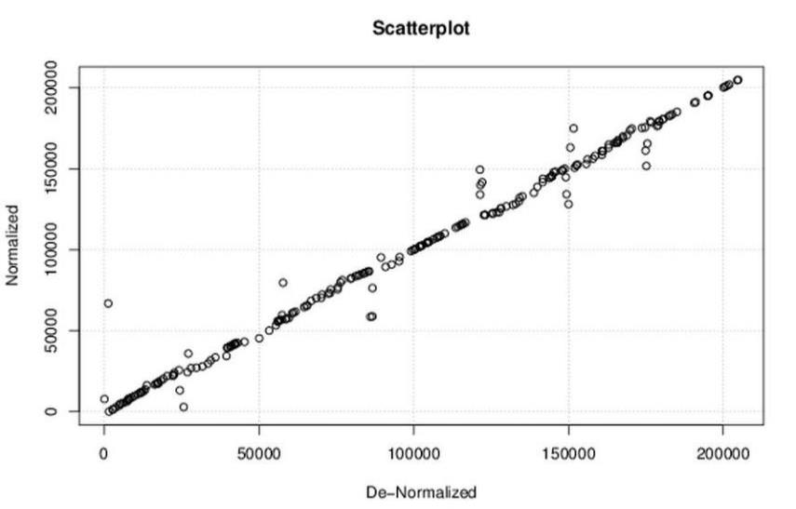
Kendell Tau (Contd..)

Slide 14
Future Work
Total Independency on schemas
Improving Ranking Quality by exploring multiple ranking options
Working on Horizontal Decomposition
Exploring Other Keyword Search Interfaces on RDBMS
Working with Huge relations and Multiple schemas.

Slide 15
References
Vagelis Hristidis, Luis Gravano, and Yannis Papakonstantinou. 2003. Efficient IR-style keyword search over relational databases. In Proceedings of the 29th international conference on Very large data bases - Volume 29 (VLDB '03), Johann Christoph Freytag, Peter C. Lockemann, Serge Abiteboul, Michael J. Carey, Patricia G. Selinger, and Andreas Heuer (Eds.), Vol. 29. VLDB Endowment.
AGRAWAL, S., CHAUDHURI, S., ANDDAS,G. 2002. DBXplorer: A system for keyword-based search over relational databases. In Proceedings of the IEEE International Conference on Data Engineering (ICDE).
HRISTIDIS, V. AND PAPAKONSTANTINOU, Y. 2002. DISCOVER: Keyword search in relational databases. In Proceedings of the International Conference on Very Large Data Bases (VLDB).
Arvind Hulgeri and Charuta Nakhe. 2002. Keyword Searching and Browsing in Databases using BANKS. In Proceedings of the 18th International Conference on Data Engineering (ICDE '02). IEEE Computer Society, Washington, DC, USA
Sphinx Documentation http://sphinxsearch.com/docs/latest/index.html Web
Rich Kelm, COO & VP of Sales, Sphinx Search
Wessa, P. (2015), Free Statistics Software, Office for Research Development and Education, version 1.1.23-r7, URL http://www.wessa.net/rwasp_kendall.wasp

Slide 16
THANK YOU

